Slide 1
MICRO CREDIT DEFAULTER
PROJECT
By
Sreyashee Jena

Slide 2
DATA PREPARATION
With the help of Pandas Library We will uploadour data to Jupyter Notebook.
Once our data is uploaded with the help of predefined method (i.e. read_csv) we can read data for further processing.
We have two type of variables in the data:-
• Dependent Variable
• Independent Variable

Slide 3
DATA CLEANING
This step include data cleaning, In this dataset there are negative values for some features like “age of network” and “amount” etc. So, removed them and replace with 0.
Most of the features are continuous and numeric so using QQ plot I check whether the data are normally distributed or not.
Outliers may have the high impact in distracting the model performance, So I used IQR and third deviation range value to replace all the outliers.
The payback amount is 6 and 12 only but some of the rows have value 0 so I remove that error data.

Slide 4
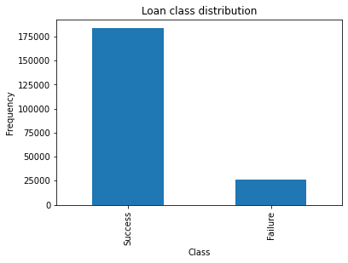
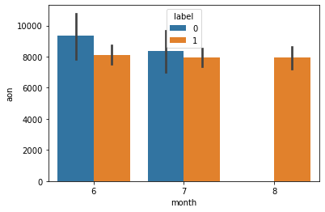
EXPLORATORY DATA ANALYSIS

Slide 5
FEATURE ENGINEERING
This step include the feature selection and feature scaling.
There are 30+ features and most of them are continuous. So, by plotting correlation heatmap it shows most then 9 features are highly correlated.
So I removed those features because this will cause problem of overfitting.
Also, Feature Scaling is important factor, as there are multiple features which had their magnitude and unit. So, to scale down at one scale I used Standardization.

Slide 6
CREATIONG MODEL
This classification prolem where dependent features is label which means if 1 – Non Defaulter, 0 – Defaulter.
So, I used multiple model and tried hyperparameter tuning with cross validation. Models are Logistic Regression, Decision Tree, Gaussian NB.

Slide 7
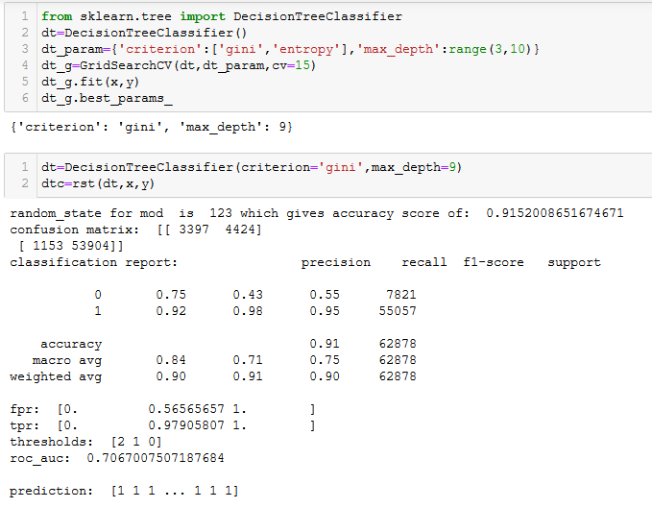
MATRICS : ACCURACY, CONFUSION MATRIX

Slide 8
Decision Tree is providing the best result in term of accuracy and less false positive value.
As Decision Tree is robust to imbalance data set because of multiple week learners and internally uses decision tree and robust to outliers.

Slide 9
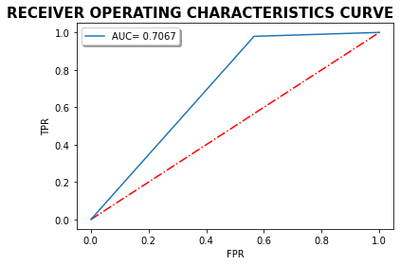
ROC CURVE
As the Roc value is near to 0.85 so it is classified the 0 and 1 efficiently and our model is performing well in this case, and area under curve is justify the prediction.

Slide 10
CONCLUSION
There are various aspect of the dataset and observation from my point of view:
From the statistical analysis it is clearly see that there is difference between the 75th percentile and max so this is an indication of the outliers in the dataset.
There is no defaulter in 8th month i.e. August month of 2016 year
In June month there are more defaulter as compared to non-defaulter and their age on cellular network is also more.
Removing unwanted column like msisdn number which does not play any imp role because that is unique.
Removing telecom circle and date column, which is also not an imp features, because telecom circle is same for all.
In this data set there are negative values which are from the total amount, age which can’t be negative.

